Slide 1
Databases With R: A Marriage Made in the Tidyverse
Databases to Dashboards
Lesson 3

Slide 2
Lesson Objectives
Explain the benefits of SQLite as a specific database system for smaller scale data
Connect to and query a database using functions in the DBI package
Manipulate data stored within a database using dplyr functions
Join data from multiple relational databases to build a data set that can be analyzed

Slide 3
Why Bother with a Relational DB?
Common use cases:
Data may already exist within a relational DB – why export and duplicate the data when you can extract it in place?
Project requires longitudinal data extracted from frequently generated files
Data set is large and exceeds the memory of the system you are working with

Slide 4
There are Many “Dialects” of SQL
Companies and open source projects have developed different approaches to database management with same underlying relational DB principles
Each solution’s SQL has a slightly different syntax:
PostgreSQL
Microsoft SQL Server
Oracle
MySQL
SQLite

Slide 5
The Lightweight Choice: SQLITE
SQLite is designed to be operated without a separate database management system (i.e. extra software) nor a database administrator
Requires less configuration than many other DB solutions
Stores DB on a single file
Unique approach to access control: access to file determines control (unlike other databases that integrate a separate access - username/password - infrastructure)
Origins of SQLite: https://thenewstack.io/the-origin-story-of-sqlite-the-worlds-most-widely-used-database-software/

Slide 6
Exercise 1
Open the R Markdown file for this lesson: “03 – Databases in R.Rmd”
Run the “setup” chunk of the file. This will ensure the packages we need for this lesson are loaded into our environment. If you receive an error because you weren’t able to load the required packages prior to the course, copy the install.package(c(“DBI”, “odbc”)) that is commented out of the setup chunk into your console and execute it.
Run the “import” chunk next. For the other exercises in this lesson we will be using a subset of the peak, sample, and batch data sets to build and query our database.

Slide 7
Connecting with Relational Databases
DBI package provides functions to connect to and perform operations on DBs
odbc package utilizes Open Database Connectivity (ODBC) drivers to connect with various types of SQL databases
RSQLite package houses driver information specific to SQLite connections

Slide 8
First Step: Connect to a Database
connection object
driver
con_name <- dbConnect(drv = driver_function,
…)
additional connection options (file, user, pass, etc.)

Slide 9
Connect to a SQLite Database
connection object
driver
con_name <- dbConnect(drv = RSQLite::SQLite(),
dbname = “file_name.sqlite”)
file to connect to
(writes file if it doesn’t exist)
https://rsqlite.r-dbi.org/reference/sqlite

Slide 10
Preserving dates and Times Requires an Additional ARgument
connection object
driver
con_name <- dbConnect(drv = RSQLite::SQLite(),
dbname = “file_name.sqlite”,
extended_types = TRUE)
argument to preserve date and time formatting
https://rsqlite.r-dbi.org/reference/sqlite

Slide 11
Build a Table from R Object
database table
name of connection
dbWriteTable(connection_object, “table_name”,
object_name)
R object to write to table

Slide 12
Append Rows to an Existing Table
database table
name of connection
dbWriteTable(connection_object, “table_name”,
object_name, append = TRUE)
R object to write to table
argument to append rows

Slide 13
Overwrite an Existing Table
database table
name of connection
dbWriteTable(connection_object, “table_name”,
object_name, overwrite = TRUE)
R object to write to table
argument to overwrite table

Slide 14
Exercise 2
Create a new SQLite database in a file called “test_database.sqlite” and name the connection object testdb. Add the “extended_types = TRUE” argument to ensure dates and times are handled correctly.
Create 3 tables - batch, sample, and peak - that correspond to each of the 3 types of files that exist in our data set.
Use the `dbListTables()` function to confirm that the 3 tables have been created.

Slide 15
Disconnect from the database when not Actively Using It
active connection object
dbDisconnect(connection_object)

Slide 16
Accessing Databases and Tables
Connection object contains information to connect with database
Database and tables NOT in memory/in R environment without additional steps
When data manipulation functions are run on database connection objects, R builds database queries without executing
When a function that requires data output is run, query will be executed
Simple function to confirm data: head will retrieve first rows in table

Slide 17
Connect to a Specific Table
database connection object
equivalent to data frame
table_object <- tbl(connection_object,
“table_name”)
database table to query

Slide 18
Connect to a Specific Table
database connection object
equivalent to data frame
batch_sql <- tbl(projectdb, "batch")
database table to query

Slide 19
Exercise 3
Confirm the data that you expect to see is available in the sample and peak tables of your test database. Create table connection objects and view the first 10 rows of each.

Slide 20
The DPLYR Package supports a wide range of data manipulation activities
ƒ(
)
ƒ(
)
ƒ(
)

Slide 21
The Select() Function ACts Like the Select Operator for Databases
Extract specific columns/variables
= Number of rows
↓ Number of Columns

Slide 22
Select Captures Specific Variables
select(batch_sql, batch_name, reviewer_name)
name(s) of columns to extract
(or a select helper) function)
data frame to transform
data frame to transform

Slide 23
Select Captures Specific Variables
table connection object
sample_subset <- select(sample_sql,
batch_name, sample_name, compound_name, sample_type, ion_ratio)
name(s) of columns to extract

Slide 24
Select Captures Specific Variables
select(batch_sql, -batch_name, -reviewer_name)
Adding “-” drops variables rather than includes them

Slide 25
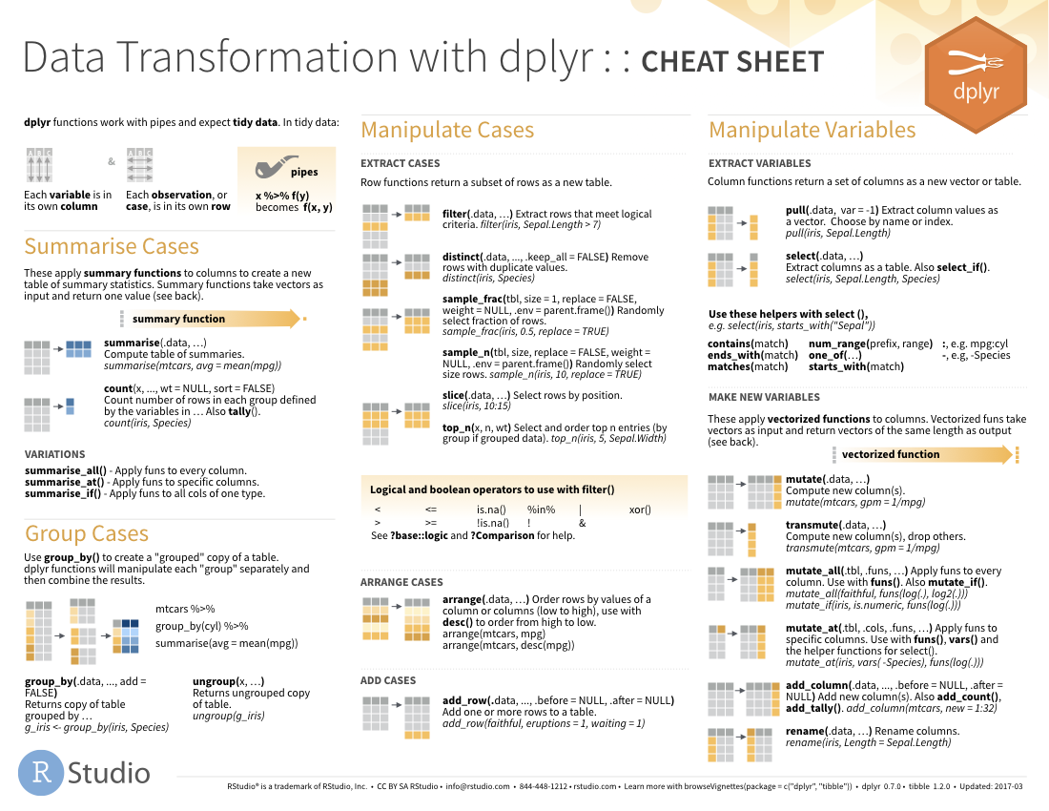
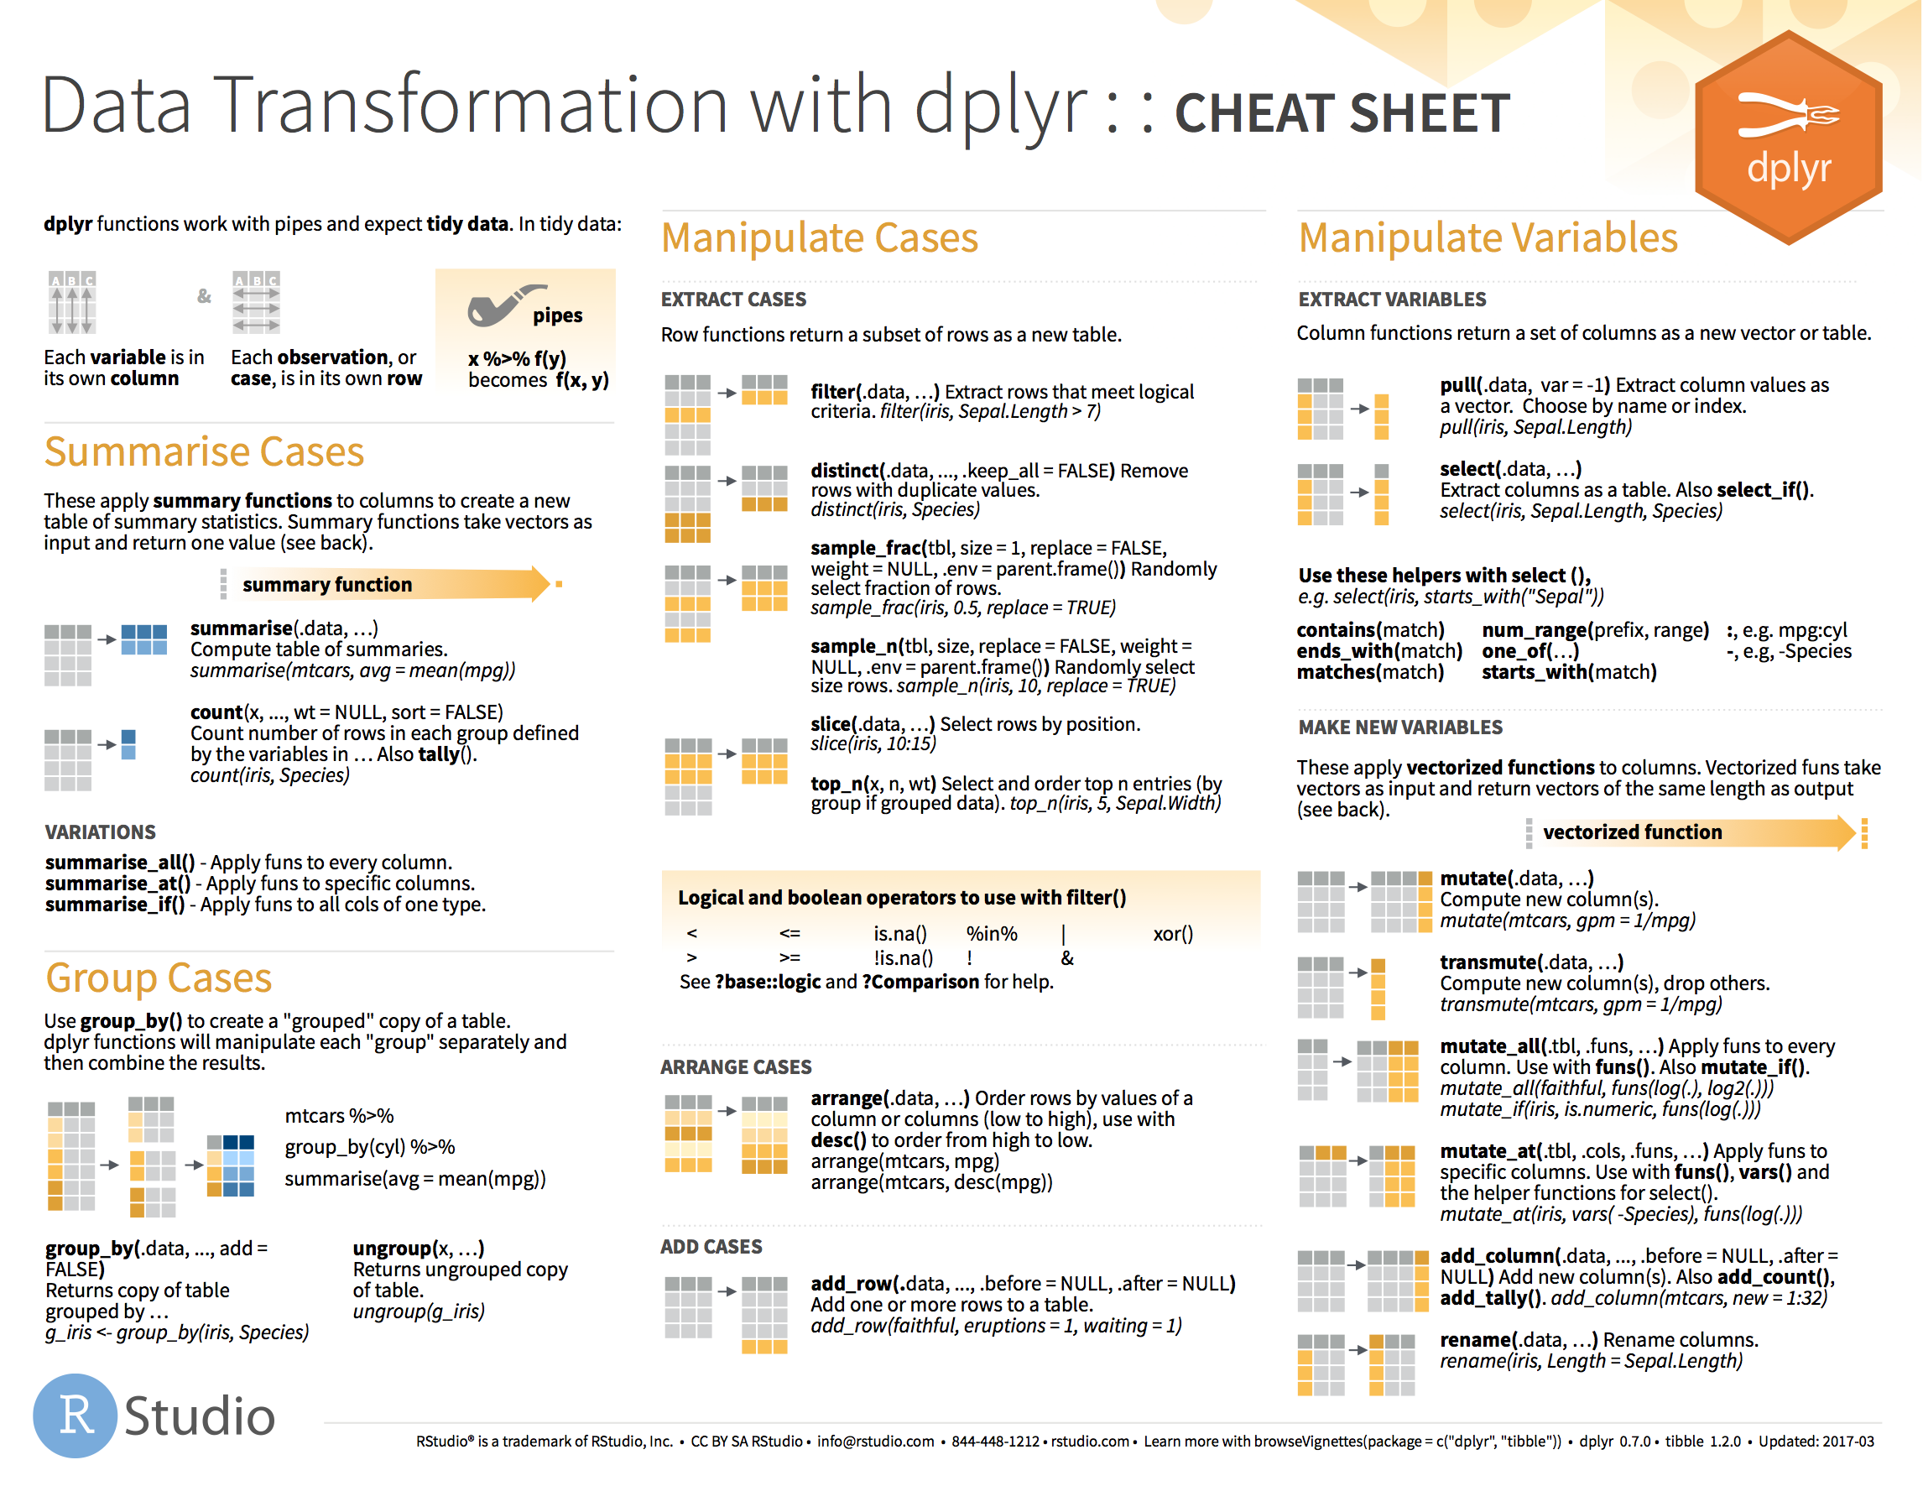
Helper Functions Support Complex Selections
25

Slide 26
The Filter() Function Acts Like a Where Clause in a SQL Statement
↓ Number of rows
= Number of Columns
Extract rows that meet logical criteria

Slide 27
Filter Captures Specific Rows
filter(data,... )
one or more logical tests (filter returns each row for which the test is TRUE)
data frame to transform
 |  |  | FALSE
 |  |  | FALSE
 |  |  | TRUE
 |  |  | FALSE
 |  |  | TRUE
 |  |  | FALSE

Slide 28
Filter Captures Specific Rows
filter(data, column_name == criteria )
one or more logical tests (filter returns each row for which the test is TRUE)
 |  |  | FALSE
 |  |  | FALSE
 |  |  | TRUE
 |  |  | FALSE
 |  |  | TRUE
 |  |  | FALSE

Slide 29
Filter Captures Specific Rows
filter(batch_sql, compound == “morphine”)
batch_name | Instrument_name | compound_name
b802253 | doc | hydromorphone
b802253 | doc | codeine
b802253 | doc | hydrocodone
b802253 | doc | morphine
batch_name | Instrument_name | compound_name
b802253 | doc | morphine
FALSE
FALSE
FALSE
TRUE

Slide 30
Filter Captures Specific Rows
Values coded as character strings must be surrounded by quotes
filter(batch_sql, compound == “morphine”)
batch_name | Instrument_name | compound_name
b802253 | doc | hydromorphone
b802253 | doc | codeine
b802253 | doc | hydrocodone
b802253 | doc | morphine
= sets
(returns nothing)
== tests if equal
(returns TRUE or FALSE)
FALSE
FALSE
FALSE
TRUE

Slide 31
Logical Tests Commonly Used with Filter()
x < y | Less than
x > y | Greater than
x == y | Equal to
x <= y | Less than or equal to
x >= y | Greater than or equal to
x != y | Not equal to
x %in% y | Group membership
is.na(x) | Is NA
!is.na(x) | Is not NA

Slide 32
The Pipe (|> ) Helps Organize Sequential Data Manipulation Activities
sample
|>
filter(____, concentration > 0)
filter(sample, concentration > 0)
sample |> filter(concentration > 0)

Slide 33
The Pipe (|> ) Helps Organize Sequential Data Manipulation Activities
sample_subset <- sample_sql |>
filter(sample_type == "standard") |>
select(sample_name, compound_name, concentration,
expected_concentration)
Sequence filter() and select() to create a subset of the data

Slide 34
Exercise 4
We are interested in visualizing the distribution of non-zero concentrations for our unknown samples in the data set.
1. Create an object sample_subset that includes only the sample data for samples with a sample_type of "unknown" and a concentration that is greater than 0. We are only interested in capturing the following variables: batch_name, sample_name, compound_name, sample_type, concentration.
2. Review the first 20 rows from your data set to confirm the rows in your data set meet your inclusion criteria.
3. Using the `ggplot()` function, create a plot that contains the histograms of concentrations (suggested binwidth = 10) faceted by compound_name.

Slide 35
DB Connections and Memory Management
Connection objects in R are NOT data frames but contain the query to retrieve the relevant data
Allow transformation and analysis of data without using memory
Data can be brought into environment as a data frame using connect() function

Slide 36
Collect() will retrieve data into a data frame
sample_subset <- sample_sql |>
filter(sample_type == "unknown", compound_name == "oxycodone") |>
select(batch_name, sample_name, compound_name, sample_type, concentration) |>
collect()
dplyr functions don’t inherently retrieve data

Slide 37

MULTIPLE TYPES OF JOINS with corresponding functions
https://dplyr.tidyverse.org/reference/mutate-joins.html
Table A
Table B
Table A
Table B
INNER JOIN
LEFT JOIN
inner_join(A, B,
by = c(“key” = “key”)
left_join(A, B,
by = c(“key” = “key”)
Table A
Table B
Table A
Table B
OUTER JOIN
RIGHT JOIN
full_join(A, B,
by = c(“key” = “key”)
right_join(A, B,
by = c(“key” = “key”)

Slide 38
Pro Tip: Use Functions that retain your data!
Table A
Table B
Table A
Table B
INNER JOIN
LEFT JOIN
inner_join(A, B,
by = c(“key” = “key”)
left_join(A, B,
by = c(“key” = “key”)
Table A
Table B
Table A
Table B
OUTER JOIN
RIGHT JOIN
full_join(A, B,
by = c(“key” = “key”)
right_join(A, B,
by = c(“key” = “key”)

Slide 39
Join Functions Can Match On Variable Names but It’s Safer to Specify Keys
batch_sample <- left_join(batch_sql, sample_sql)
batch_sample <- left_join(batch_sql, sample_sql, by = c("batch_name", "compound_name"))
batch_sample <- left_join(batch_sql, sample_sql,
by = c("batch_name” = “batch_name”,
"compound_name” = “compound_name”))
syntax when variable names don’t match

Slide 40
Reminder: Some Functions may require that data be collected into environment
batch_sample <- left_join(batch_sql, sample_sql, by = c("batch_name", "compound_name"))
summary(batch_sample)
is not equivalent to
batch_sample <- left_join(batch_sql, sample_sql, by = c("batch_name", "compound_name")) |>
collect()
summary(batch_sample)

Slide 41
Use full_join when exploring whether there are data not joined by keys
sample_peak_with_IS <- full_join(sample_sql, peak_sql,
by = c("batch_name", "sample_name", "compound_name")) |>
collect()
Internal standard data are not joined by compound_name

Slide 42
Exercise 5
We are interested in investigating the acceptance criteria for peak areas for our quantifier and qualifier data. We would like to focus on the standards with an expected concentration of 100 and review the peak area distributions for both quant and qual data. We are going to only focus on the compounds of interest and not internal standard data (internal standards use a different compound_name). Use filter to subset the sample data to only standards with an expected concentration of 100 and then join the sample and peak tables. Plot histograms of the peak areas for quantifier and qualifier ions (separately).

Slide 43
Lesson Objectives
Explain the benefits of SQLite as a specific database system for smaller scale data
Connect to and query a database using functions in the DBI package
Manipulate data stored within a database using dplyr functions
Join data from multiple relational databases to build a data set that can be analyzed

Slide 44
What Else? Local vs. Remote Databases
Database
Consider creating a lightweight local database in these scenarios:
A large number flat files holding data
Desire to decrease duplication of data between files
Periodic refreshes to data
Flat Files

Slide 45
What Else? Local vs. Remote Databases
Database
Encryption
Database Server
Local database
Analysis Server
Connection to a server/resource hosting the database
Most common = Open Database Connectivity (ODBC)
Secure transportation of data (encryption)
Credentials to access the database

Slide 46
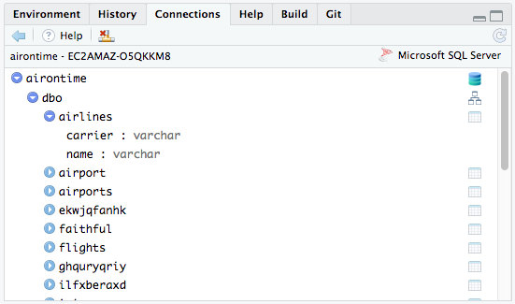

What Else? Connection Menu in RStudio
Details at: https://support.posit.co/hc/en-us/articles/115010915687-Using-RStudio-Connections-in-the-RStudio-IDE

